Slide 1

Telco Customer Churn Analysis
Brandon Rumbarger

Slide 2
Problem
Customer churn reduces revenue
Retention is cheaper than acquisition
High competition makes switching easy
Difficult to identify at-risk customers
Goal: Predict churn and identify key drivers
Approach
Data split: 70% training / 30% testing
Dataset: Telco Customer Churn
-~7,000 customers
Model: Logistic Regression
Key variables:
  -Tenure
  -Monthly Charges
  -Contract Type

Slide 3
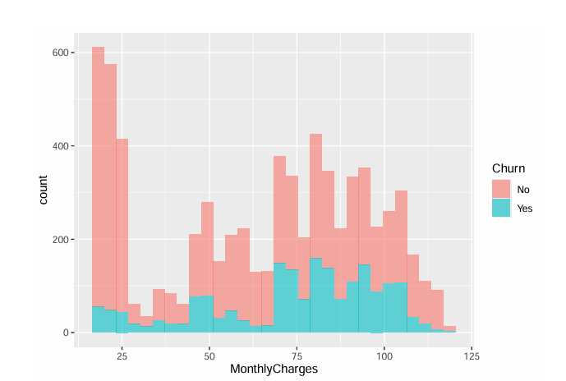
Insights
Accuracy:78.8%
AUC:0.83
Higher monthly charges have more churn
Longer tenure have less churn
Month-to-month contracts have the highest churn
Accuracy: 78.8%
AUC: 0.83

Slide 4
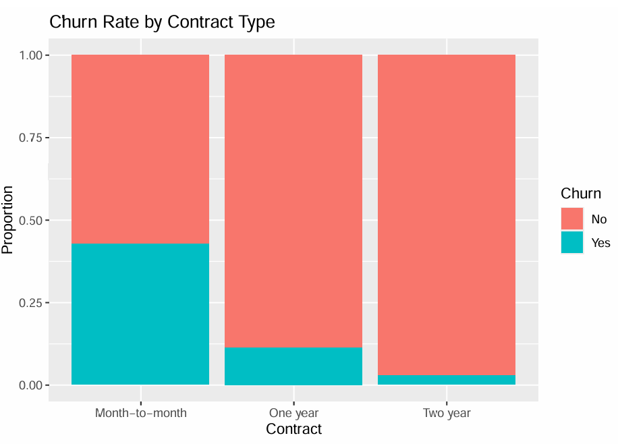
ResultS
Month-to-month contracts have the highest churn
Long-term contracts have the lowest churn
Contract type is the strongest predictor of churn
Results
Promote long-term contracts
Target high-risk customers
Review pricing strategy

